Slide 1


Comp Tech LLC - Final Project
Romeo Casiano, King Awhaetoma, Emmaline Mercer, Trey Coon, Jaden Howard, Nathan Foster

Slide 2
Requirements
EM
The Comp Tech LLC requires a secure wireless network that clients can access to utilize their available resources without accessing private information, and they also desired a guest wireless network.
All employees will be a part of their respective VLANs depending on their department: Marketing and Sales, Accounting and Financial Services, IT Infrastructure Management, Programmers, or Process Analyst and Quality Management.
Finally, they needed a Management VLAN controlled by four IT and two Programmer employees who would be responsible for the new network management.
These requirements will be outlined in the topology so that CompTech LLC’s needs can be easily implemented.

Slide 3
Contributions
Romeo Casiano: logical topology, subnetting, and cabling
King Awhaetoma: logical topology, subnetting, and cabling
Emmaline Mercer: Project Report and Presentation
Nathan Foster: technology costs and labor costs
Jaden Howard: physical topology
Trey Coon: explanation of services

Slide 4
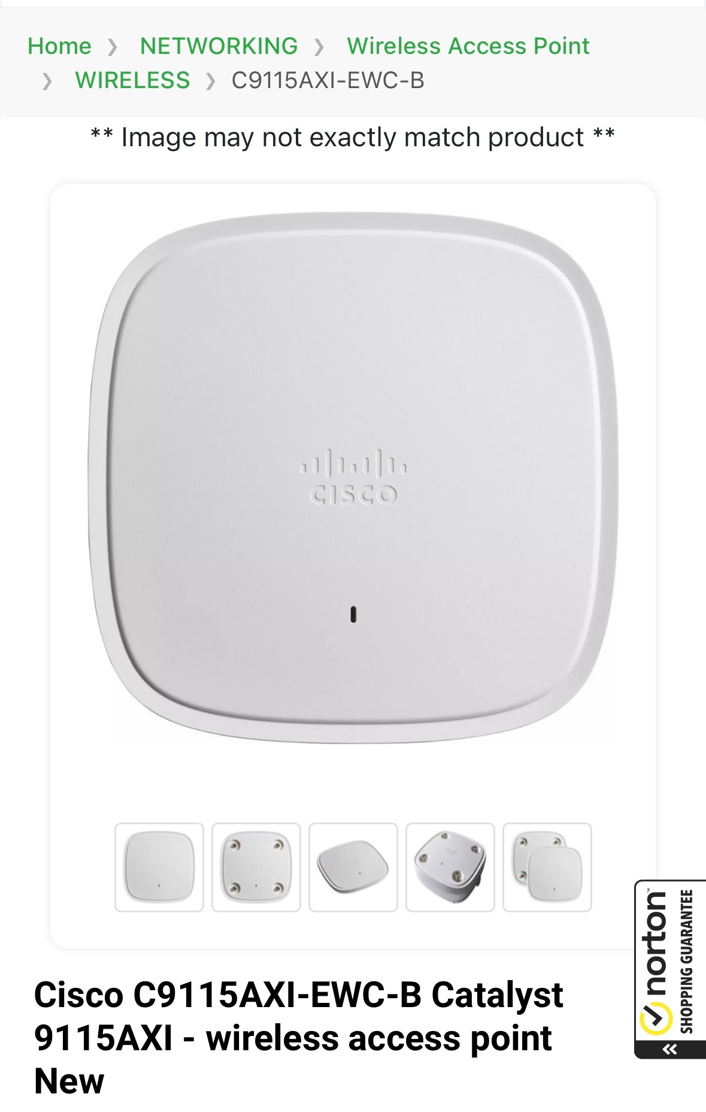
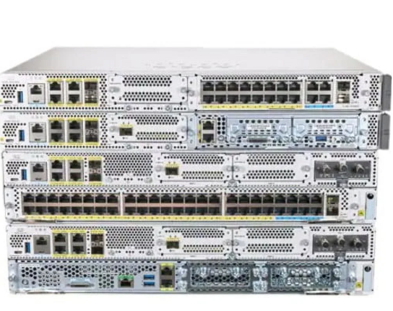
Costs
2 Routers
$5,041 each
5 Switches
$1,270 each
10 Cisco C9115AXI-EWC-B Catalyst 9115AXI Access Points
$682 for a 5 pack
Cabling Cat6a
$273 for 1000ft
Labor Cost x6
$75 per hour

Slide 5
Explanation of Services
What can we do or put in place to ensure that CompTech LLC’s new branch is equipped with a reliable, secure, and scalable network infrastructure to support daily operations and future growth?
Our explanation of services will show off what techniques and implementations we make along the way in order to meet our scenario's end goal.

Slide 6
Questions going into our Service Configuration
How can we ensure future proof scaling?
What is the most consistent approach for users and network configuration alike?
Example: Minimal downtime, clear and uninterrupted communication
Benefits
Why is being able to proactively address issues going to be important for the future?
How can we ensure security alongside scalability?

Slide 7
VLAN Configuration
How It Works:
Each department at CompTech (e.g., IT Infrastructure, Programmers, Accounting) will be assigned to its own VLAN. A separate VLAN will be created for wireless clients and a management VLAN for IT staff.
Why It’s Important:
Segregates departmental traffic, ensuring sensitive data (e.g., Accounting) isn’t accessible to other departments.
(How can we ensure security alongside scalability?)
Reduces unnecessary broadcast traffic for improved network performance.
Simplifies management and enhances security, especially for the data center on the 3rd floor.

Slide 8
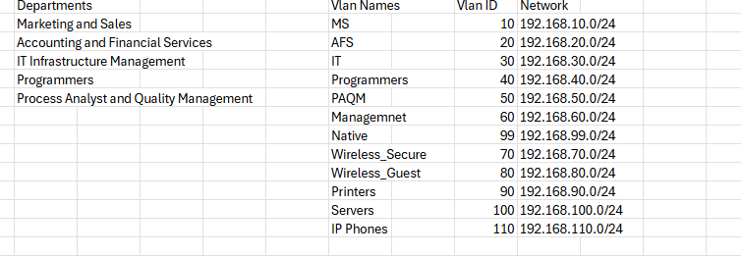
IP Addressing and Subnetting
How It Works for our scenario:
Each VLAN will be assigned a unique subnet.
Why It’s Important:
Organizes IP addresses, preventing conflicts and enabling smooth communication between devices.
Ensures secure, logical segregation of network traffic while supporting future scalability.

Slide 9
DHCP Configuration
How It Works:
A DHCP server will automatically assign IP addresses to all devices, including employee PCs, IP phones, and wireless devices. Different DHCP scopes will be created for each VLAN.
Why It’s Important:
Simplifies IP address management for 168 employees and multiple devices.
Ensures scalability as the company grows without manual IP configuration.
(How can we ensure future proof scaling?)

Slide 10
Alerts
Customizable Notifications:
Used to communicate important updates or maintenance schedules to users accessing the device.
Prevents surprises by keeping administrators informed of scheduled downtime or changes.
An applied example of this would be our MOTD
Customizing alerts and making sure systems are notifying admins is a paramount dynamic in today's reliability and model of networking administration.

Slide 11
Wireless Access Points (WAPs)
Employee traffic is segmented from guest and client traffic, with encryption protocols ensuring secure communication.
The guest network operates on a completely isolated VLAN, providing access to the internet without exposing internal resources.
IMPORTANT: This segmentation enhances overall security while maintaining a seamless user experience for visitors.
Does not hinder users - but endlessly makes maintaining a smooth process flow more secure and reliable on a day to day.

Slide 12

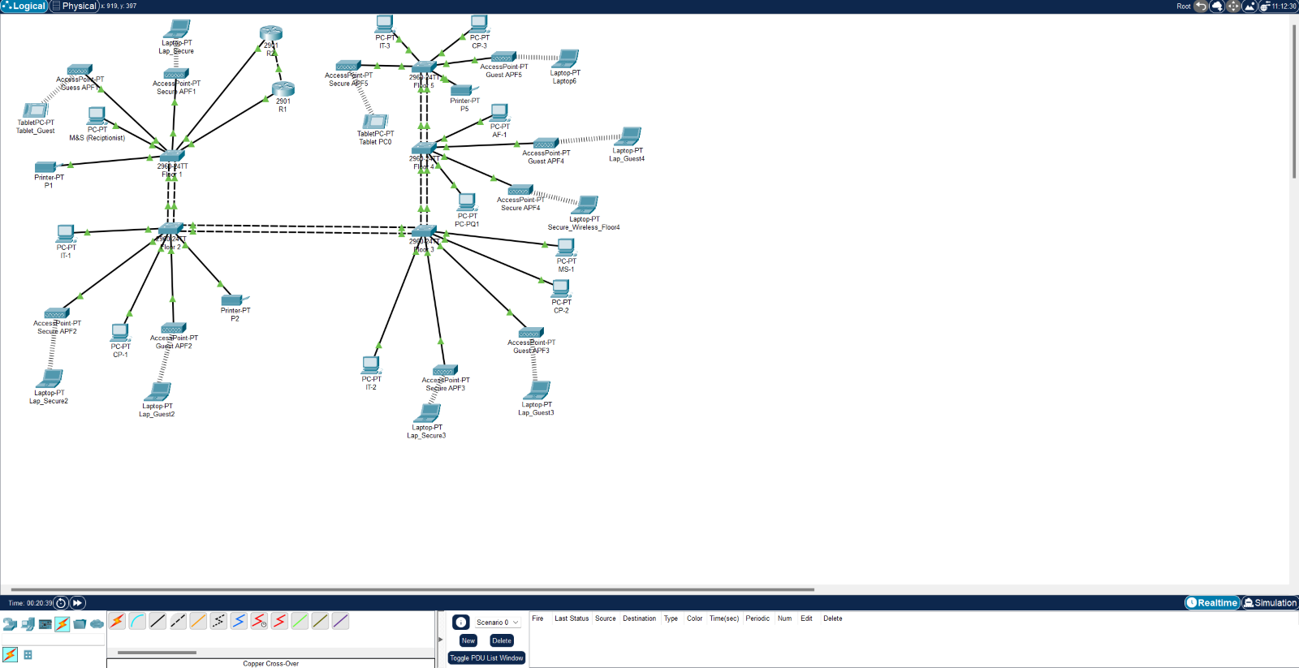
Logical Topology
Devices Used:
5 2960-24TT Switches
2 2901 Routers
10 Access Points
Copper Cross-Over and Copper Straight Through Cables
23 End Devices
Process for the Network:
Implementing EtherChannel throughout the Switches
Configuring the Router’s
Creating a DHCP Pool
Creating VLANS and Implementing VLAN Trunking
Assigning End Devices to their Proper VLANS

Slide 13
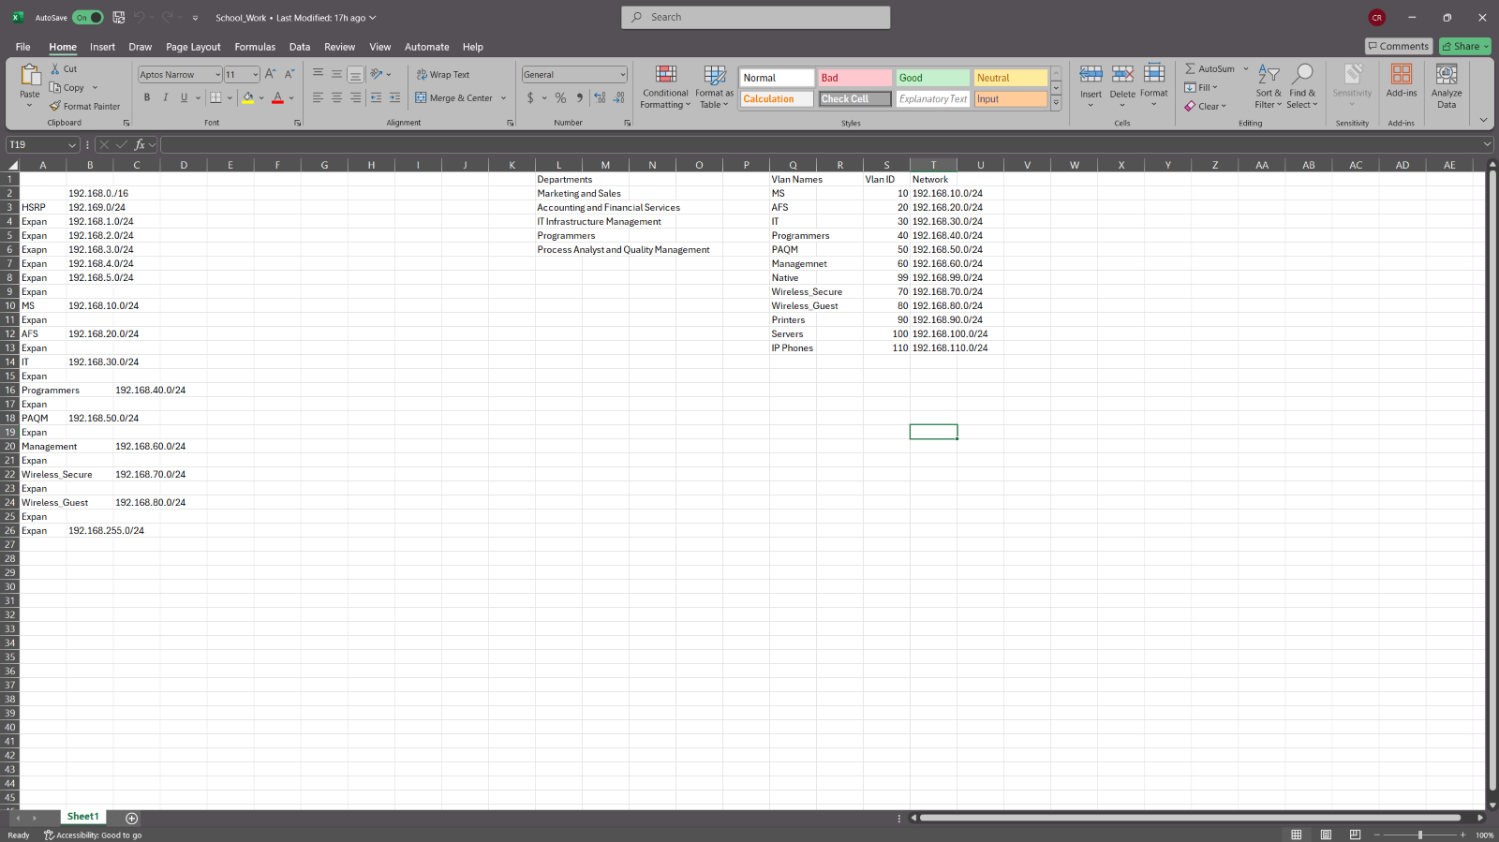
Subnet
Subnetting:
Went with /24 design
Capable of up to 254 usable devices
Challenges/Struggles:
Subnetting in General
How to Start

Slide 14
Physical Topology

